Slide 1





Federal Health Information Modeling and Standards (FHIMS) Work Group
Mitra Rocca - Co-chair, Government Projects WG
Steve Wagner - Program Manager, FHA FHIMS WG
© 2002-2010 Health Level Seven ®, Inc. All Rights Reserved. HL7 and Health Level Seven are registered trademarks of Health Level Seven, Inc. Reg. U.S. Pat & TM Off

Slide 2
Work Group
Vision & Goals
Support the Federal Health Architecture (FHA)
eGov Initiative
  To effectively use information technology to improve the safety, quality and efficiency of health and healthcare for all Americans
Establish the Federal Health Interoperability
Modeling & Standards (FHIMS) Work Group as part of an overall FHA Standards Program
  Program Manager: Steve Wagner (ONC/FHA)
Establish an Information Modeling Project to produce a unified Federal Health Information Model (FHIM) harmonized across Federal Agencies and Standards Organizations
  UML Domain Models
  Definitions, Standards, & Value Sets
© 2002-2010 Health Level Seven ®, Inc. All Rights Reserved. HL7 and Health Level Seven are registered trademarks of Health Level Seven, Inc. Reg. U.S. Pat & TM Off
3

Slide 3
Participants
Steering Group Members:
  DoD [Nancy Orvis]
  SSA [Justine Piereman]
  CDC [Nikolay Lipskiy]
  VHA [Tim Cromwell]
  NCI [George Komatsoulis]
  CMS [Theresa Lissauer]
Information Modeling Project comprised of volunteers from:
DoD / MHS | CDC
VA / VHA | SSA
HHS | SAMHSA
CMS | IHS
FDA | NCI
NLM | FHA
All are encouraged to invite Subject Matter Experts (SMEs) from their respective organizations to provide insight and input on models, standards, and definitions.
© 2002-2010 Health Level Seven ®, Inc. All Rights Reserved. HL7 and Health Level Seven are registered trademarks of Health Level Seven, Inc. Reg. U.S. Pat & TM Off
4

Slide 4
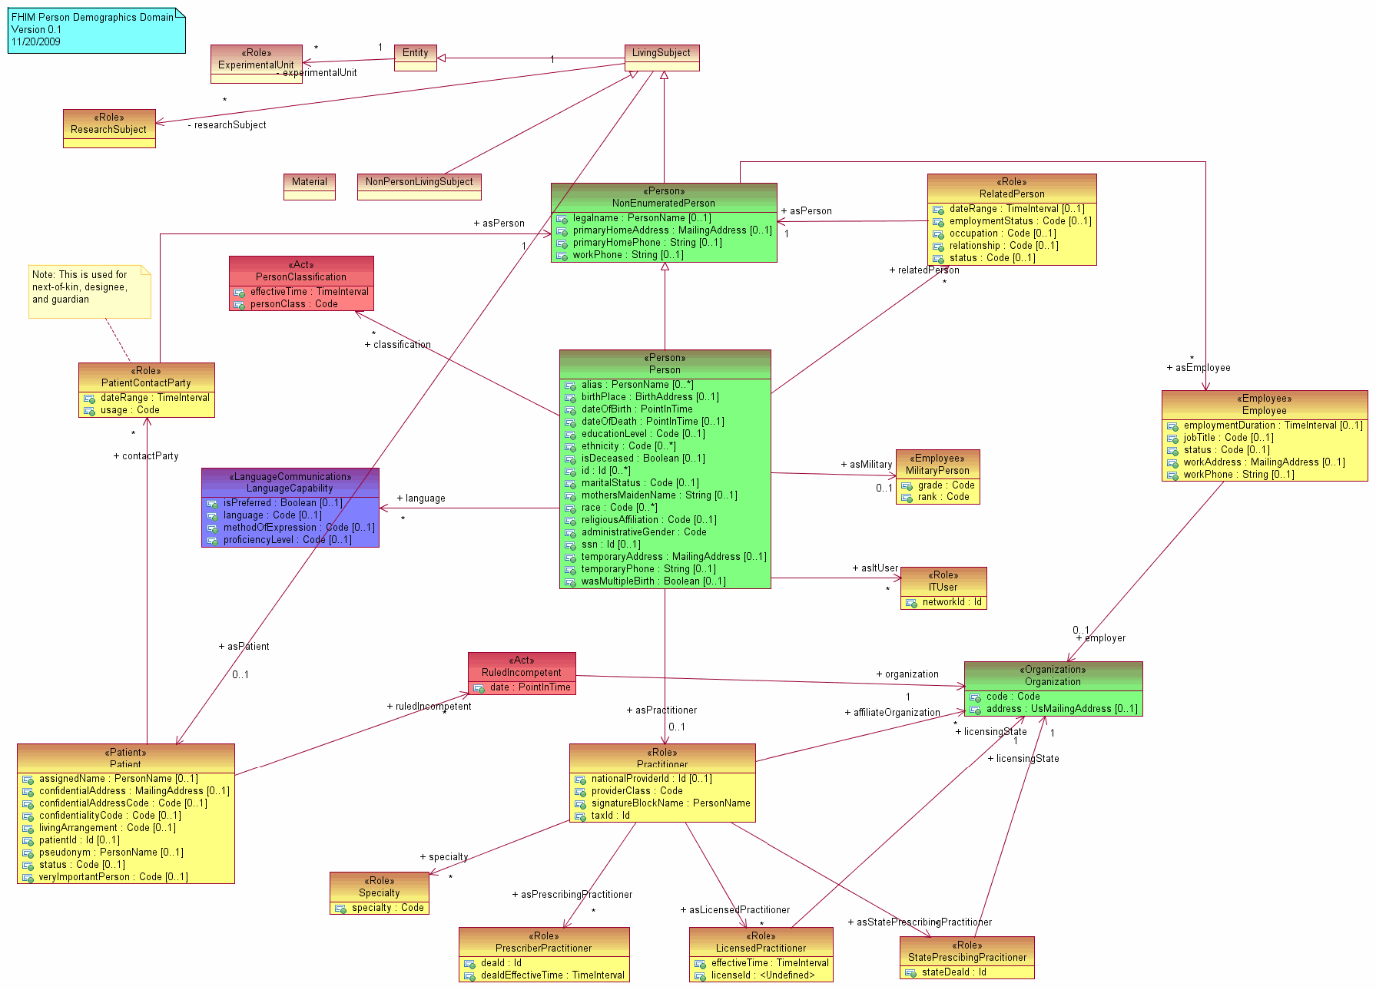
Action Plan
Information Model
  Develop a logical, UML based, health information model
Terminology Models
  Develop terminology
models/value sets in
conjunction with and
in support of the information model
Implementation Models
  Integrate information and terminology models with Open Health Tools open source implementation modeling tools
© 2002-2010 Health Level Seven ®, Inc. All Rights Reserved. HL7 and Health Level Seven are registered trademarks of Health Level Seven, Inc. Reg. U.S. Pat & TM Off
5

Slide 5
Modeling Approach
Sept 2009
Nov 2009
Dec 2009
Jan 2010 … ongoing…
Draft
Models /
Document
Concepts
& codes
Provide
Models, Specs,
Definitions to SDOs & Agencies
Define
Strategy
Define
Modeling
Process
Define
Style
Guide/
Tools
Vet
Model &
Concepts
Generate
Interoperability
Specifications
Gather
Participants
Establish
Workgroups
Harmonize
Feedback
Repeats for each domain
Create a baseline model from existing VA, NCI and FDA models
Use the HL7 RIM as a reference model
Harmonize information across the FHA Federal Partners/Agencies
Harmonize with information defined by health SDOs and HITSP
Identify concepts and terminologies in need of harmonization
Fully document coded data attributes and their value sets
Vet model, terminologies/value sets and definitions with FHA Federal Partners/Agencies and harmonize final comments
Use model driven architecture approach to produce interoperability specifications
Integrate model approach and content into existing SDO development processes
Interoperability specifications available for FHA Partners/Agencies to leverage
© 2002-2010 Health Level Seven ®, Inc. All Rights Reserved. HL7 and Health Level Seven are registered trademarks of Health Level Seven, Inc. Reg. U.S. Pat & TM Off
6

